Slide 1
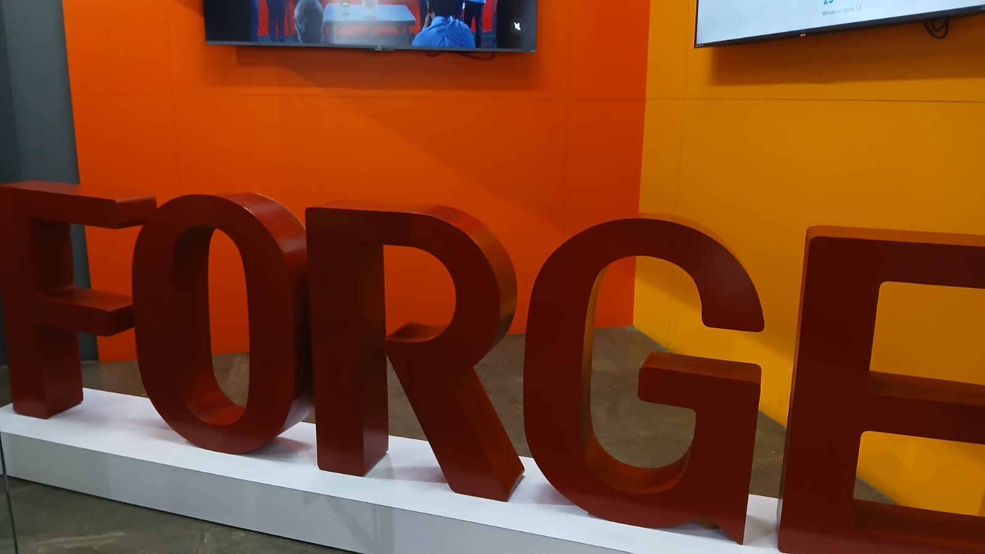
WEEK 0
PROTOSEM
Orientation Week Recap
Add Group Photo Here
Four days of introductions, games, talks, and team spirit
that kicked off our journey together.

Slide 2
WHAT HAPPENED
Week 0 at a Glance
A quick look at all four days before we dive in
01
02
03
04
DAY
DAY
DAY
DAY
Icebreakers &
Introductions
Discover &
Present
Stories, Talks &
Team Games
Learning &
Launch
Self & class intro
Rock Paper Scissor game
LinkedIn session
16Personalities test
Short story presentation
Story presentations continue
ITEC TechTalk
Imposter, Challenge &
Marshmello games
TechTalk: Art of Prompting
Orientation by Hema
Leaderboard briefing
Official Inauguration

Slide 3
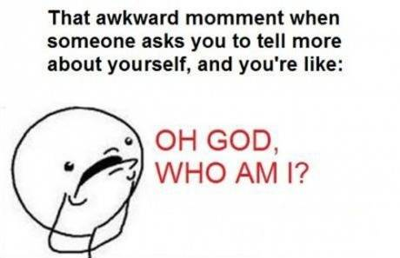
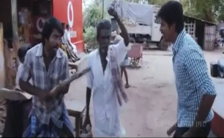
DAY ONE
Icebreakers & Introductions
Getting to know each other, the fun way
1
Introduction by RAM & MEERA
Everyone introduced themselves and the class got a first look at how Protosem would run — people, purpose, and expectations for the weeks ahead.
2
Rock Paper Scissor Game
A high-energy elimination tournament that broke the ice fast, got everyone laughing, and turned strangers into teammates within minutes.
Add Day 1 Photos Here

Slide 4
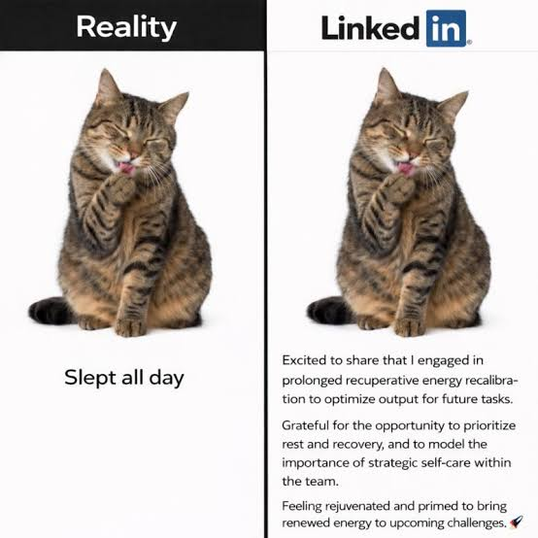
DAY TWO
Discover & Present
Building a professional presence and sharing our stories
1
LinkedIn Session
A guided walkthrough on building a strong LinkedIn profile — setting the stage for professional networking.
2
16Personalities Test
Everyone took the 16Personalities assessment to better understand their own working and communication styles.
Add Day 2 Photos Here
3
Short Story Presentation
Participants kicked off their short story presentations, sharing creativity and public speaking skills with the group.

Slide 5
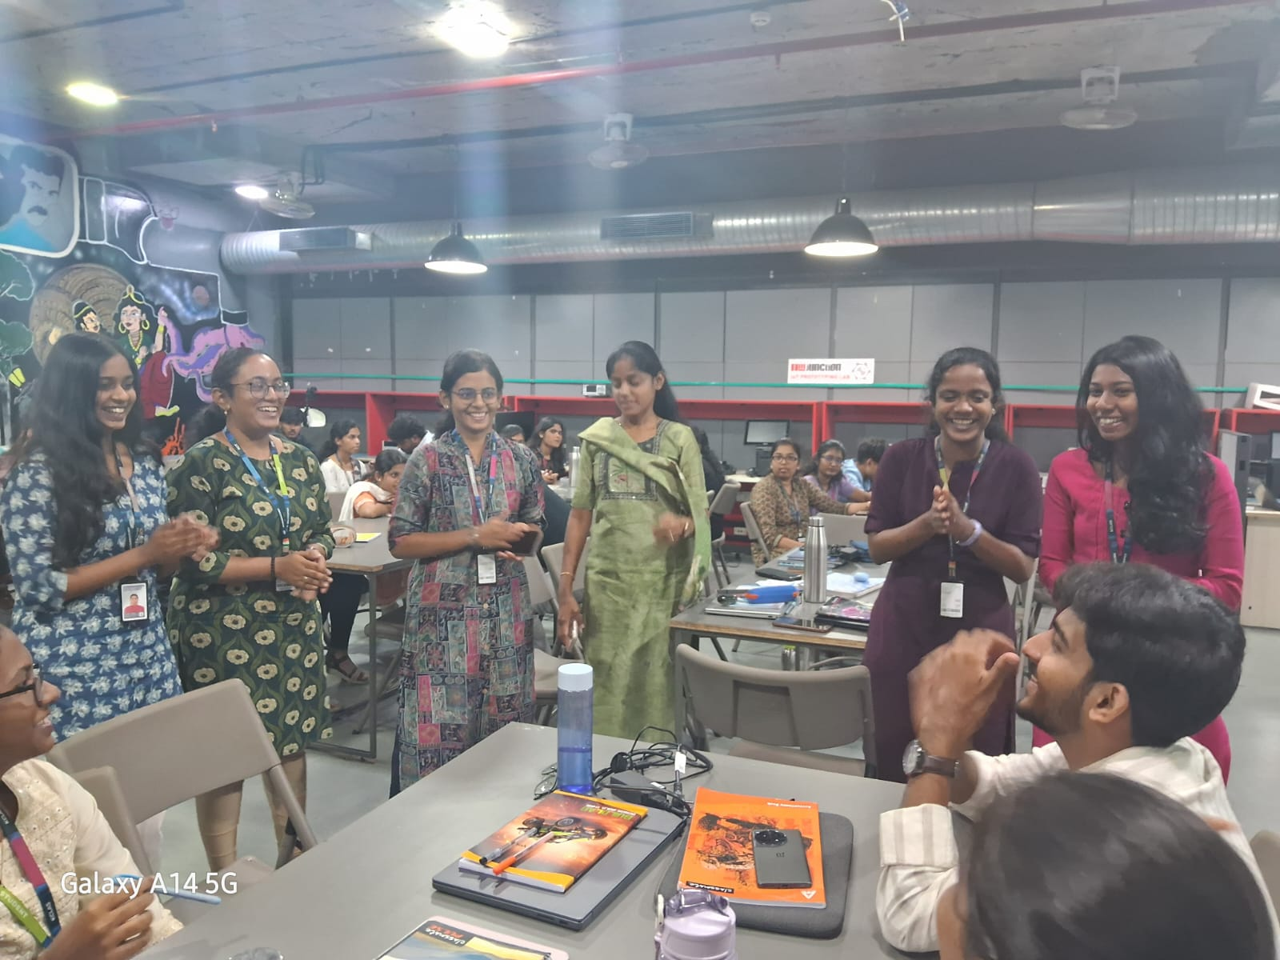
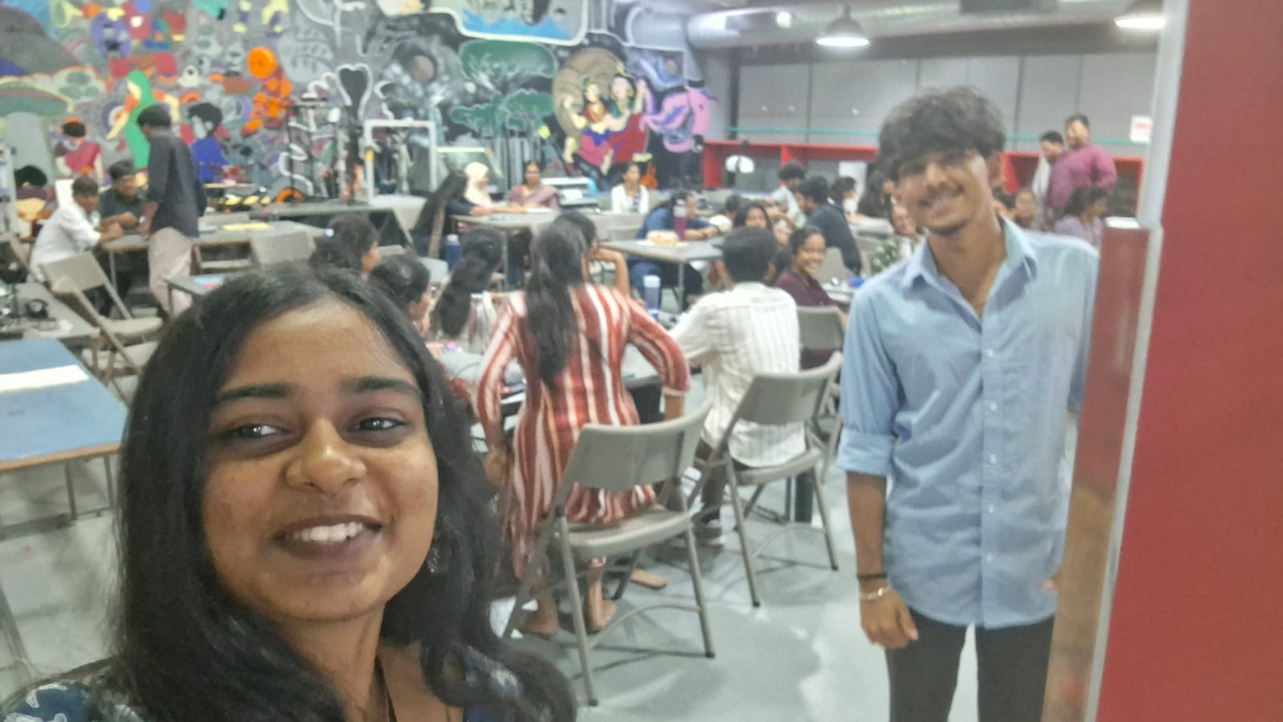
DAY THREE
Stories, Talks & Team Games
Our busiest day — presentations, tech talk, and non-stop games
1
1
ITEC TechTalk
An insightful tech talk session hosted by ITEC.
2
Imposter Team Game
3
Challenge Game
A team-based social deduction game that tested trust and teamwork.
A fast-paced challenge that pushed teams to think on their feet.
4
Marshmello Game
A hands-on building challenge that had teams racing the clock.
Add Day 3 Photo

Slide 6
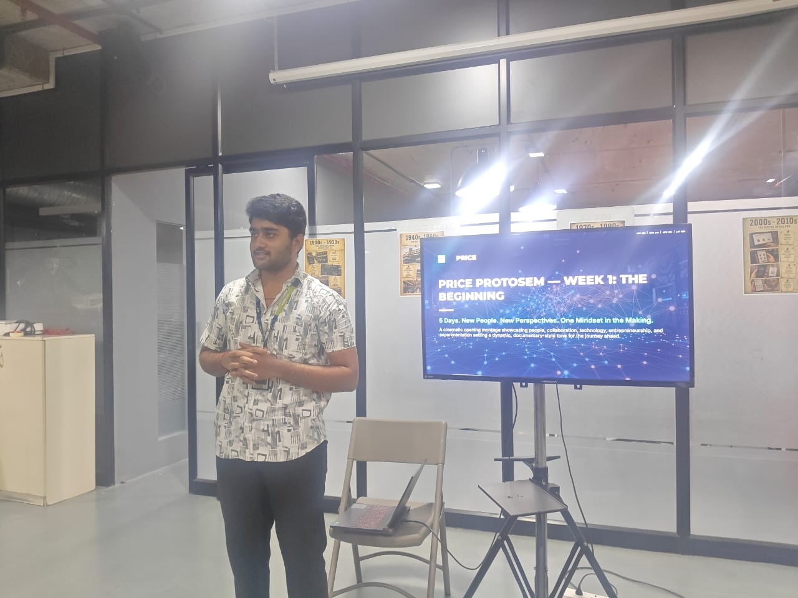
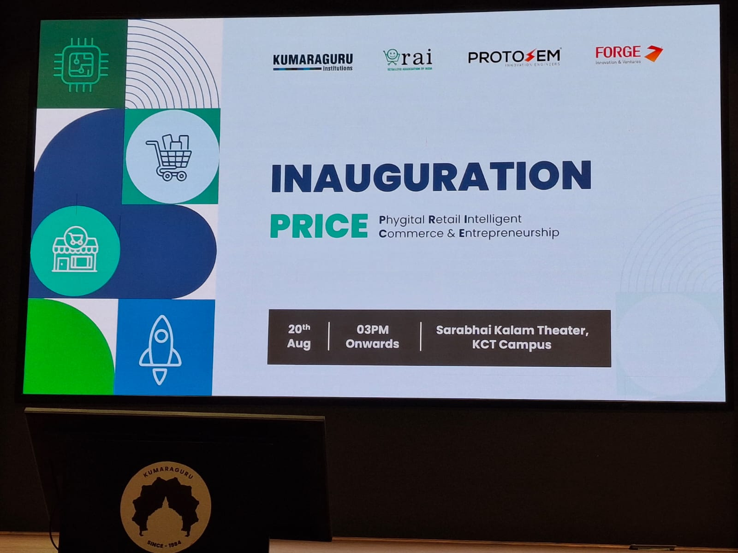
DAY FOUR
Learning & Launch
Wrapping up orientation and officially kicking things off
1
TechTalk: The Art of Prompting
A dedicated tech talk on prompt engineering — how to communicate effectively with AI tools.
2
Orientation Session by Hema
A comprehensive orientation session led by Hema, covering everything participants needed to know going forward.
3
Leaderboard Instructions
A walkthrough of how the leaderboard works and how points would be tracked through the program.
4
Official Inauguration
Protosem was officially inaugurated, marking the formal start of the program.

Slide 7
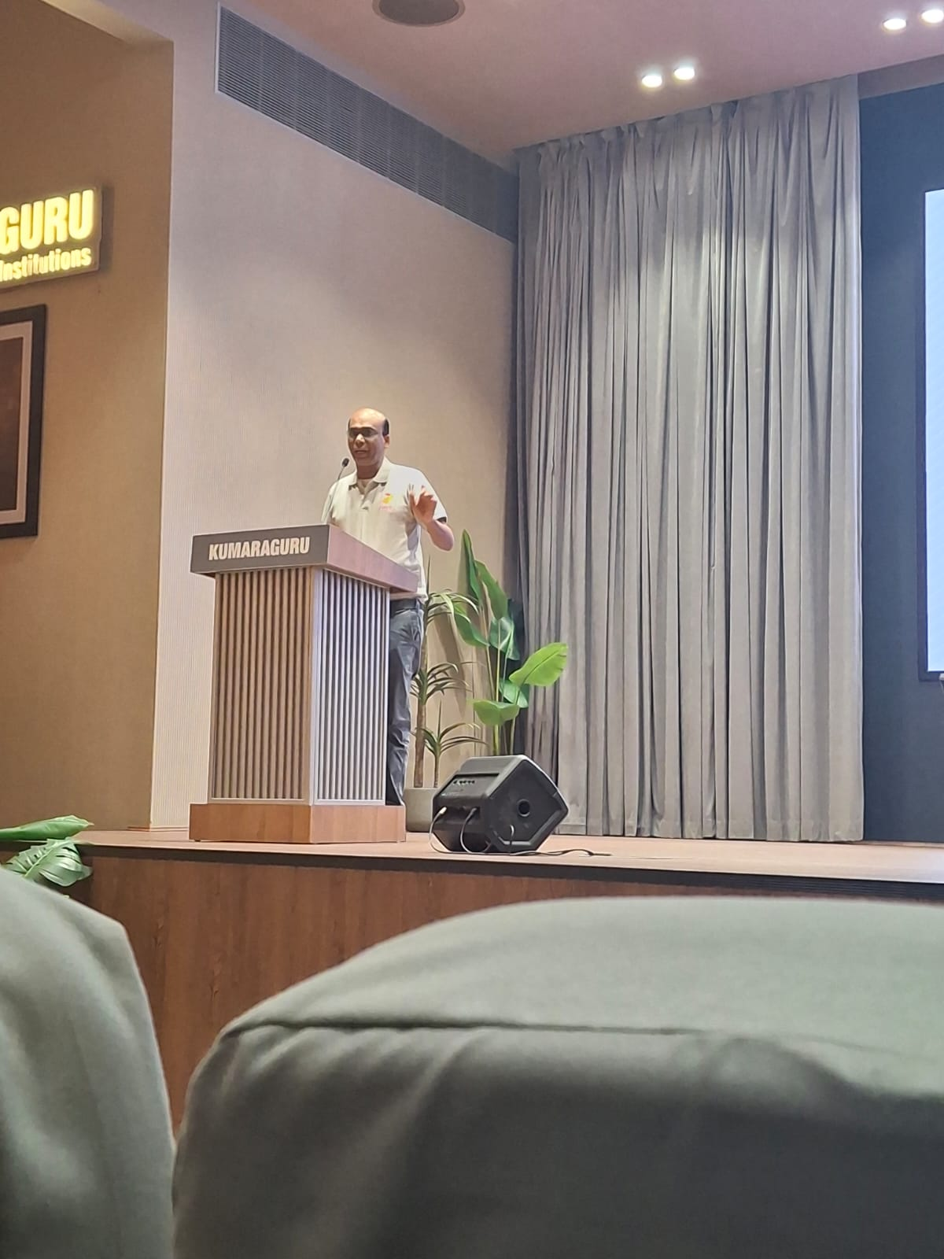
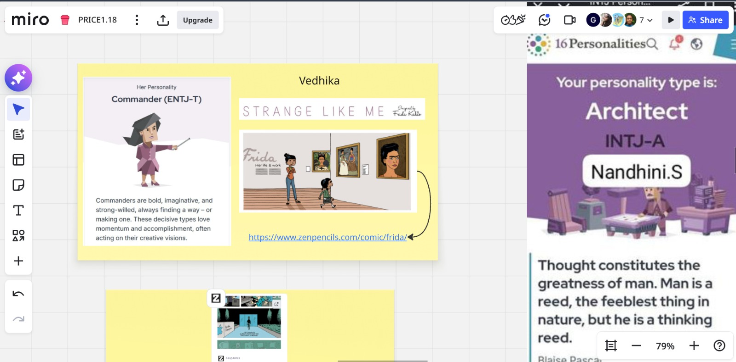
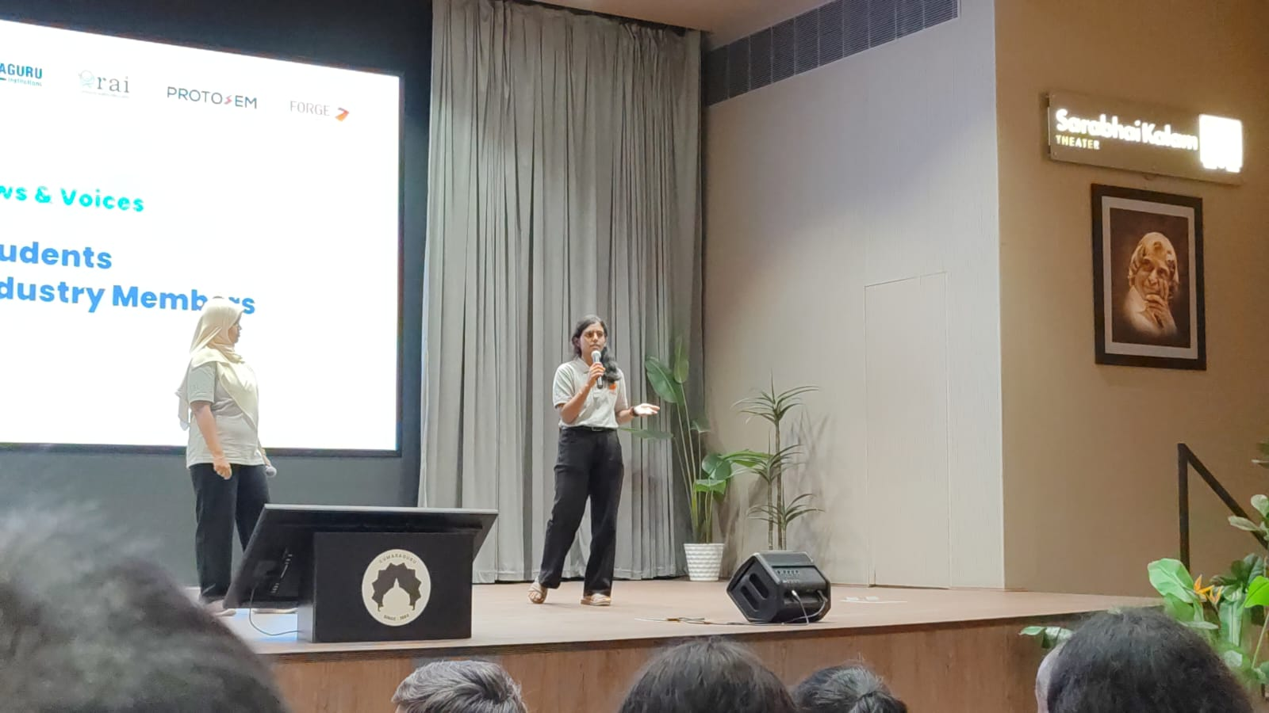
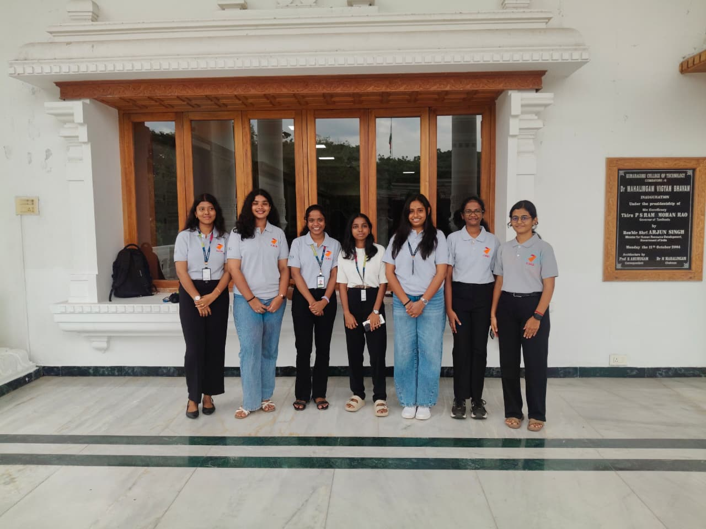
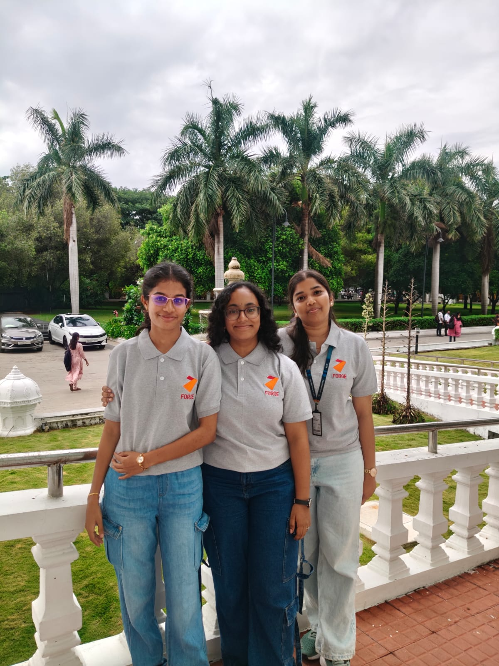
THAT'S WEEK 0
On to Week 1
Thank you to everyone who introduced, presented, played,
and showed up for a great start to Protosem.
Add Photo
Add Photo
Add Photo

